Slide 1

Statistics
Art of Making Decisions in the light of uncertainty

Slide 2
Statistics ( COSAIPC )
Collection
Organizing
Analyze
Interpret
Presentation
Conclusion
Decisions are best made with the aid of facts and data.
Machine Learning with out statistical analysis is completely non sense.

Slide 3
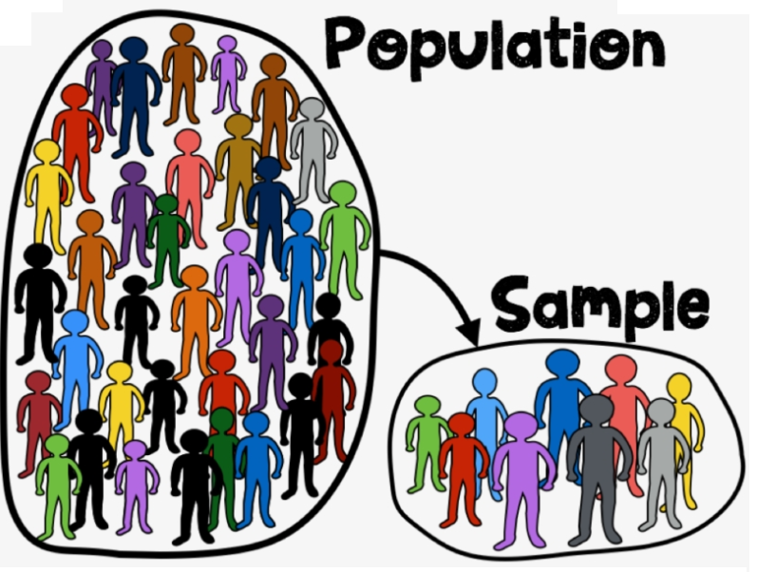
Terminologies
Data : raw scattered, unstructured info
Variable : characteristic of each element of a population or sample.
Random Variable : Values described by chance, numerical function on the outcomes of a probability space
Sample and Population
• Parameter: A numerical value summarizing all the data of an entire population (Mean, Median, Mode).
• Statistic: A numerical value summarizing the sample data.
Estimation and Approximation.

Slide 4
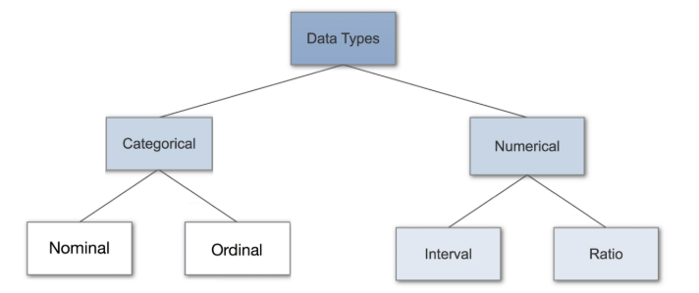
Types of Data
Categorical Data : Pie Chart and Bar Chart
Numerical Data :Histogram, Box Plot, Line Plot and many others.

Slide 5
Statistics vs Machine Learning
Statistics : we have Problem, then we collect Data.
Machine Learning : We have Data , we have to find Solution.
Data >>> Solution
Problem >>> Data

Slide 6
Statistics Types
Descriptive Statistics: method of organizing, summarizing, and presenting data in an informative way (numerical facts, figures, or information) (population to sample )
Inferential Statistics: deals with COLLECTED SAMPLE data and to make an inference, correlation, conclusion, decision, estimate, prediction, or generalization about a population, based on sample.

Slide 7
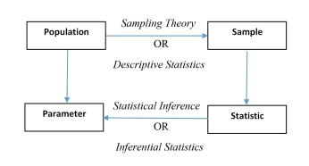
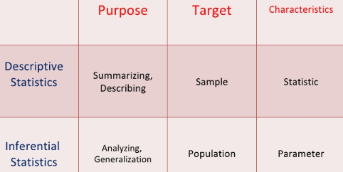
Two Types of Statistics

Slide 8
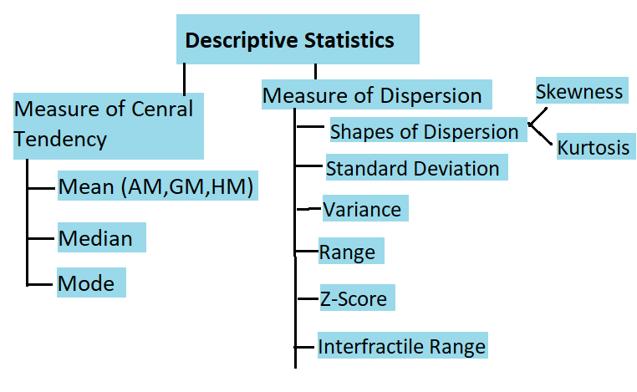
Descriptive Statistics

Slide 9
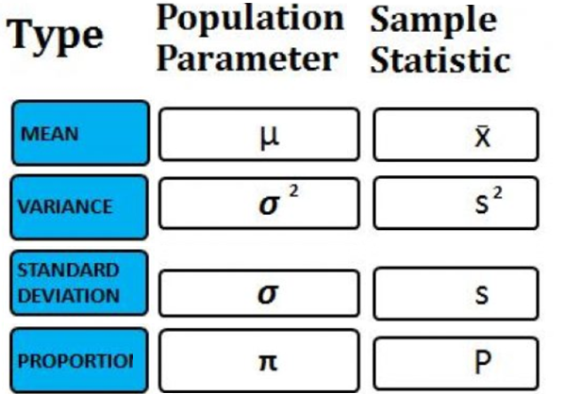
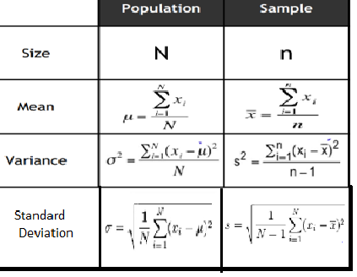
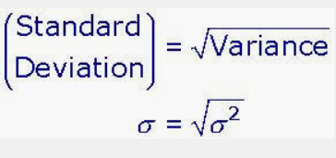

Parameters vs Statistics

Slide 10
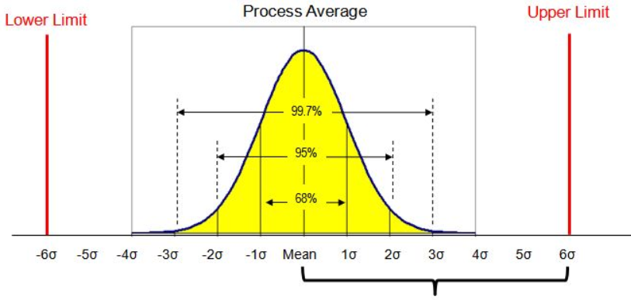
Significance of Sigma ( 4 sigma , 6 sigma )

Slide 11
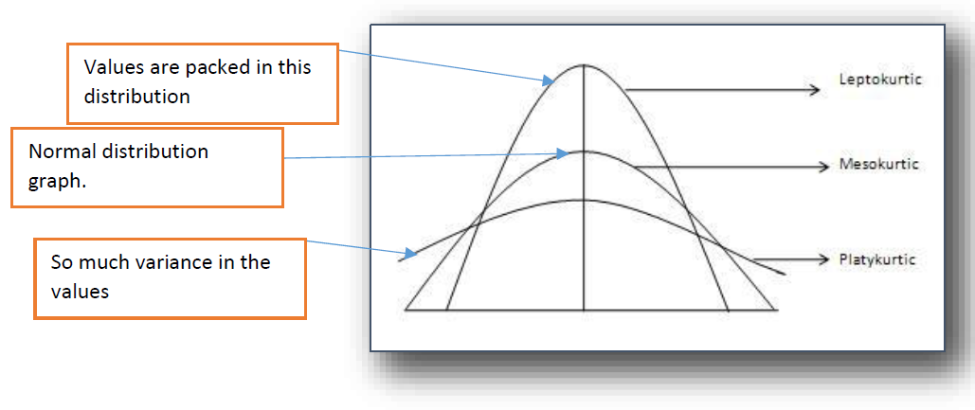
Kurtosis

Slide 12
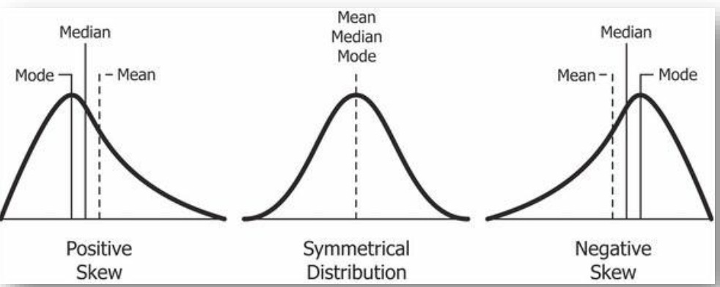
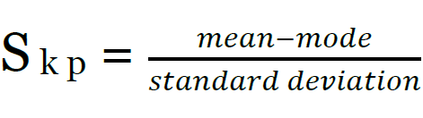
SKEWNESS
Sk = -0.5 to +0.5 No skewness Sk = -0.8 to +0.8 Moderate skewness -1 < Sk > +1 : Skewness

Slide 13
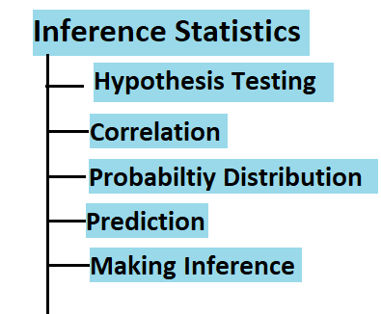
Inference Statistics

Slide 14
Three types of Analytics
1) Descriptive Analytics :historical data
2) Predictive Analytics : predict future
3) Prescriptive Analytics : making future
favorable.
Example : sales, cricket player century

Slide 15
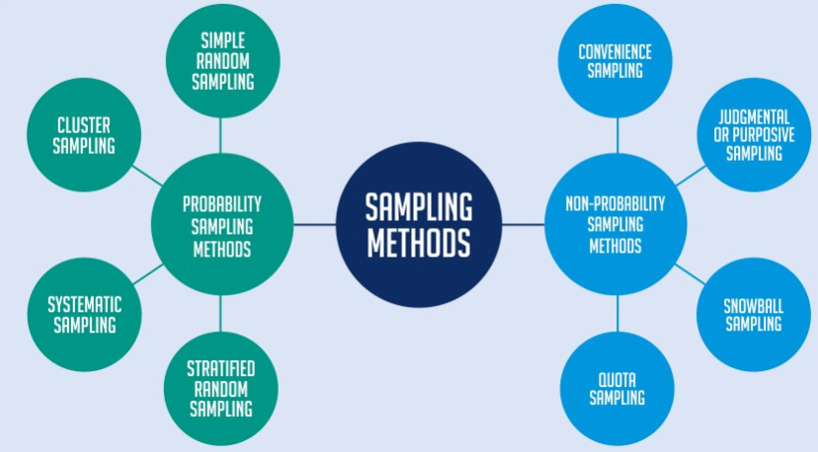
Sampling

Slide 16
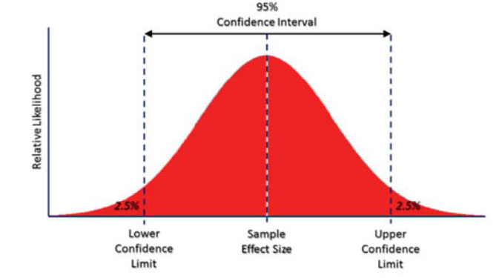
Confidence Interval

Slide 17
Probability
Measurement of uncertaininty
Independent Events: A and B are independent iﬀ:
P(A ∩ B) = P(A)P(B)
P(A|B) = P(A)
P(B|A) = P(B)
Conditional Probability: P(A|B) = P(A,B)/P(B)
Bayes Theorem: P(A|B) = P(B|A)P(A)/P(B)
Joint Probability: P(A,B) = P(B|A)P(A)
Marginal Probability: P(A

Slide 18
Probability Distribution Function
A probability distribution is a function that describes the likelihood of obtaining the possible values that a random variable can assume. In other words, the values of the variable vary based on the underlying probability distribution.
Probability distributions describe the dispersion of the values of a random variable. Consequently, the kind of variable determines the type of probability distribution
Two Types of Distributions:
Probability Mass Functions for discrete variables ( PMF )
Probability Density functions for continuous variables ( PDF )

Slide 19
Types of Discrete Distribution
Binomial distribution to model binary data, such as coin tosses.
Poisson distribution to model count data, such as the count of library book checkouts per hour.
Uniform distribution to model multiple events with the same probability, such as rolling a die.

Slide 20
Types of Continous Distribution

Slide 21
Discrete probability mass distributions functions where each particular value has a non-zero likelihood,
But specific values in continuous distributions have a zero probability. For example, the likelihood of measuring a temperature that is exactly 32 degrees is zero.

Slide 22
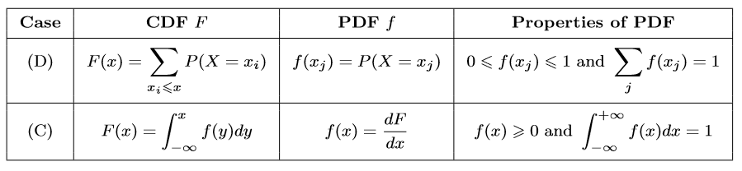
Probability Density Function (PDF) Gives the probability that a rv takes on the value x: pX(x) = P(X = x)
Cumulative Density Function (CDF) Gives the probability that a random variable is less than or equal to x: FX(x) = P(X ≤ x) Note: The PDF and the CDF of a given random variable contain exactly the same information.

Slide 23
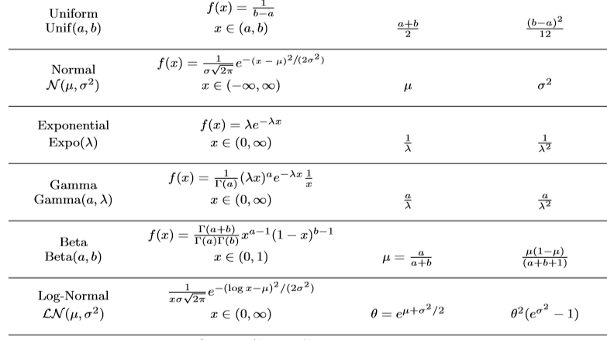
Continous Probabilty Distributive Function

Slide 24

Central Limit Theorem
Mean of all sample of population ~ mean of population as number of observations in sample increases.
Sample would be normal distributed if n>30
Sample would be normal distributed but population should be normally distributed (In case of n<30)

Slide 25
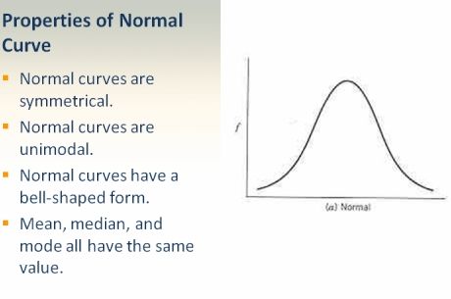
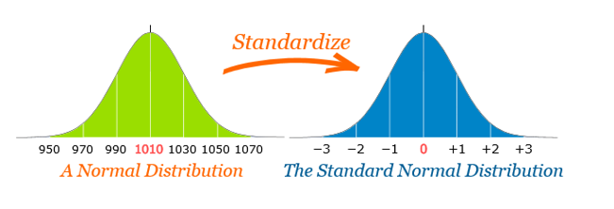
Normal Distribution vs Standard Normal Distribution

Slide 26
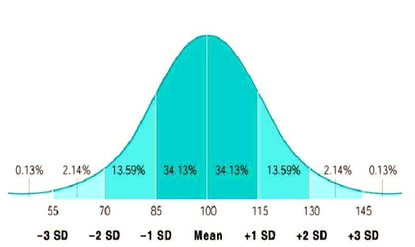

Slide 27
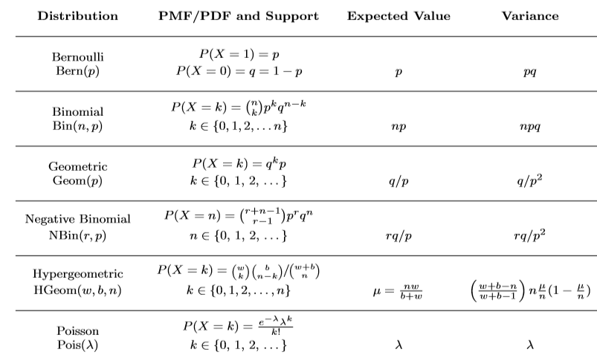
Discrete Probability Function Distribution

Slide 28
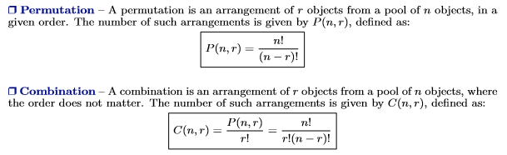
Permutations vs Combinations

Slide 29
Parametric Tests vs Non Parametric Tests

Slide 30
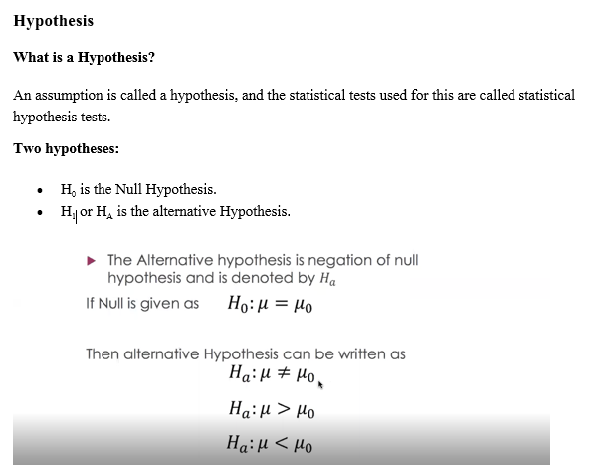
Hypothesis Testing

